Slide 1
EARLY PREDICTION OF DIABETIC RETINOPATHY TEAM 8
GUIDE NAME
Mr. KIRAN KUMAR REDDY
SUBMITTED BY
G.VARSHITHA REDDY -(20R21A6727)
D.BHARATH varma - (20R21A6713)
G.NIHARIKA - (20R21A6723)
G.HARSH VARDHAN - (21R25A6703)

Slide 2
CONTENTS
INTRODUCTION
ABSTRACT
SWOT ANALYSIS
EXISTING SYSTEM
PROPOSED SYSTEM
SYSTEM ARCHITECTURE
IMPLEMENTATION
CONCLUSION
REFERENCES

Slide 3
INTRODUCTION
People who have diabetes may develop diabetic retinopathy, an eye disorder that can lead to blindness and vision loss. The retina's blood vessels are impacted (the light sensitive layer of tissue in the back of your eye). It's crucial to undergo a thorough dilated eye exam at least once a year if you have diabetes. Although diabetic retinopathy may not initially present with any symptoms, detecting it early might help you take precautions to preserve your vision. You can avoid or delay vision loss by controlling your diabetes by staying active, eating well, and taking your medications. There are typically no symptoms in the early stages of diabetic retinopathy. Some patients experience vision changes, such as difficulty reading or seeing objects in the distance.

Slide 4
ABSTRACT
The main aim for this project is early prediction of diabetic retinopathy (blindness caused due to high blood pressure) using machine learning from scan B ultrasonography screening images. Diabetic Retinopathy (DR) is an eye disease in humans with diabetes which may harm the retina of the eye and may cause total visual impairment. Therefore it is critical to detect diabetic retinopathy in the early phase to avoid blindness in human. In at least 90% of new cases, progression to more aggressive forms of sight threatening retinopathy and maculopathy could be reduced with proper treatment and monitoring of the eyes. Our aim is to detect the presence of diabetic retinopathy by applying machine learning classifying algorithms. Hence we try and summarize the various models and techniques used along with methodologies used by them and analyze the accuracy and results.

Slide 5
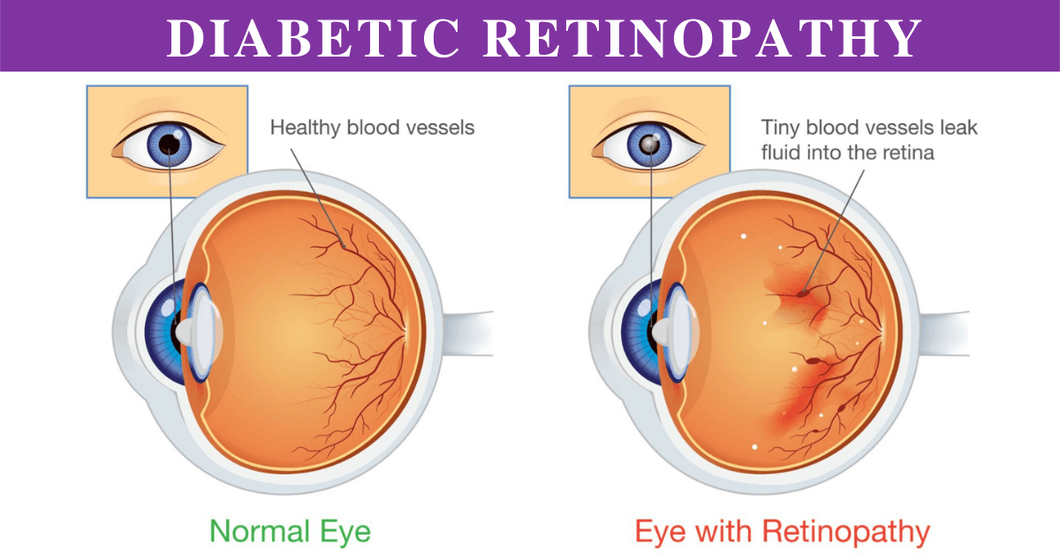
DIABETIC RETINOPATHY

Slide 6
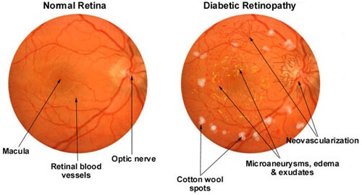

Slide 7
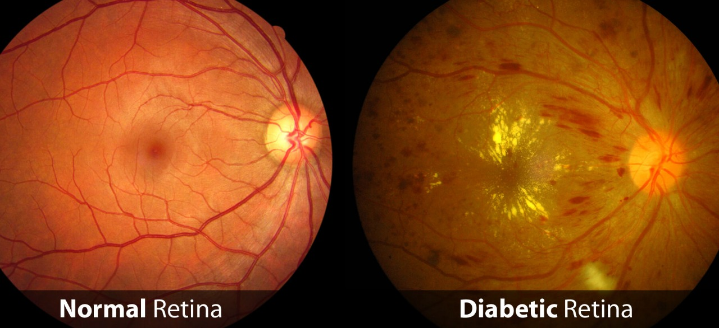
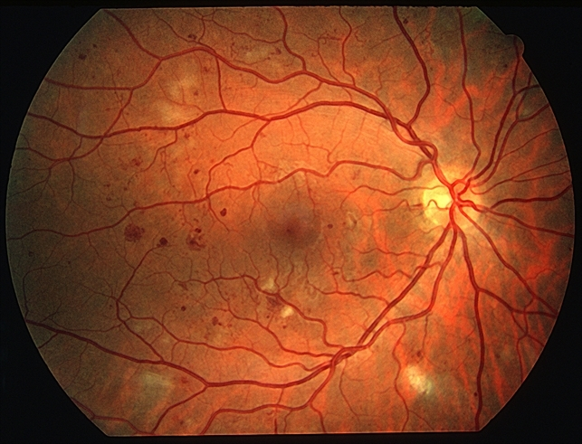
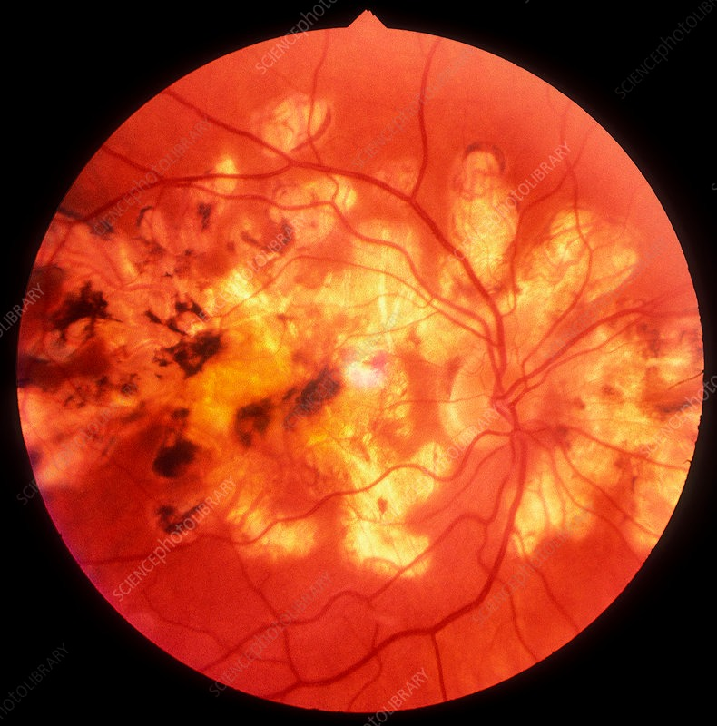

Slide 8
S
W
STRENGTHS
WEAKNESSES
Increased research and development.
Emergence of personalized medication.
Can help a person catch the condition early to prevent complications.
Absence of biomarkers.
Lack of tools for course correction and improve the quality of patient's life.
Lack of identification of novel pathways that can help deliver more effective treatment.
SWOT
OPPORTUNITIES
THREATS
New promising drugs are in pipeline.
Large patient pool allows companies to make cost-effective drugs.
Low doses of vector for gene delivery without prompting an immune response provide opportunity to companies.
Expiry of patent of widely marketed drugs and availability of biosimilars can hinder the market's growth.
Screening rate remains low for minority and low-income population.
O
T

Slide 9
EXISTING SYSTEM
Traditional approaches and models for prediction contain a variety of risk factors and consist of many algorithms' metrics, including datasets, programs , and much more. The classification of patients as High-risk or Low-Risk is based on the results of the group tests. However, these models are only useful in clinical settings; they are not useful in broad industry sectors. We therefore applied the principles of machine learning and supervised learning methods to construct the predictions system in order to include the illness predictions in many health-related industries.

Slide 10
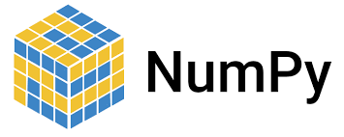
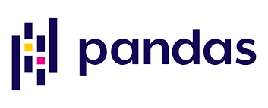
PROPOSED SYSTEM
In this project we propose a novel and efficient method to diagnose retinopathy from retinal fundus images using SVM algorithm and by using Python Libraries Numpy and Pandas.

Slide 11
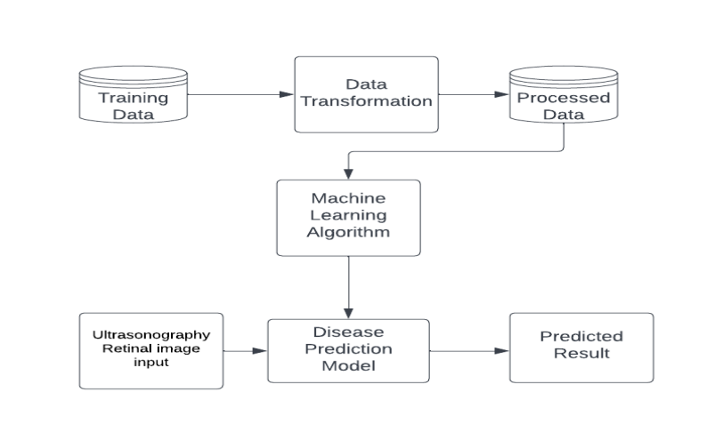
SYSTEM ARCHITECTURE

Slide 12
IMPLEMENTATION
Here we use SVM(Support Vector machine) to categorize the features of the processed image and categorize them based on their matched features.
The algorithm creates a line or a hyperplane which separates the data into classes. At first approximation what SVMs do is to find a separating line(or hyperplane) between data of two classes.
SVM is an algorithm that takes the data as an input and outputs a line that separates those classes if possible.

Slide 13
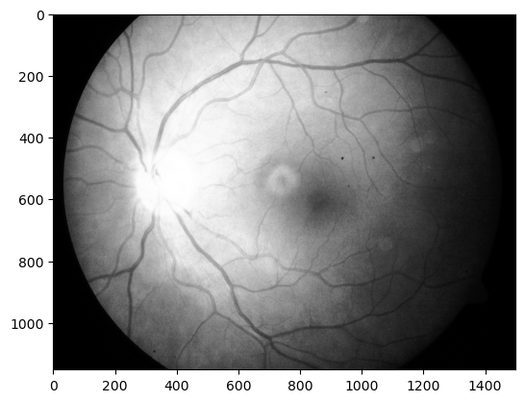

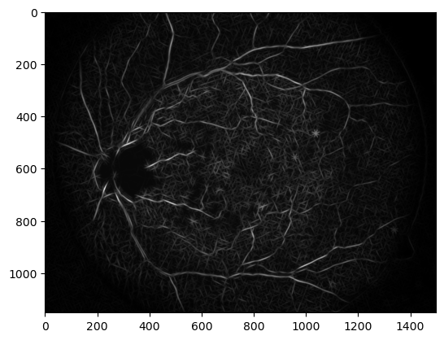
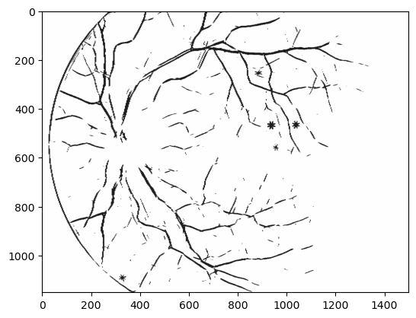
B&W Image
Scaled down image
gaussian_matched_filter_kernel
Final output image

Slide 14
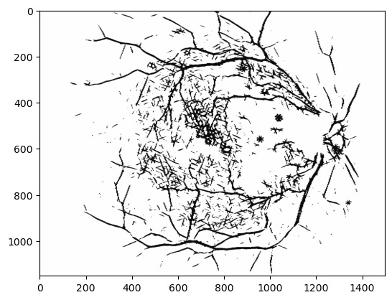
OUTPUT
*represents effected region

Slide 15
CONCLUSION
Diabetic Retinopathy is a very common eye disease in people having diabetes. This disease can lead to blindness if not taken care of in early stages, This project is a part of the whole process of identifying Diabetic Retinopathy in its early stages. In this project, we'll extract basic features which can help us in identifying Diabetic Retinopathy in its early stages.

Slide 16
THANK YOU

